Slide 2
Nils Lau
År | Virksomhed | Rolle
2021 | Itm8 A/S | Information Security Manager
2018 | Itadel | Information Security Manager
2012 | JNdata | Afdelingschef for Process Management
2008 | Region Syddanmark | IT direktør
2004 | IBM | Kvalitetschef
1999 | DMdata | Kvalitetschef
1986 | LEC | Afdelingschef
1982 | Århus Skolevæsen | Lærer Idræt, matematik og IT – underviser lærerne i Århus i IT
2016 | DNV | Lead Auditor Certificering af virksomheder i ISO 9001, ISO 27001, 27701 og ISO 22301, WLA

Slide 3
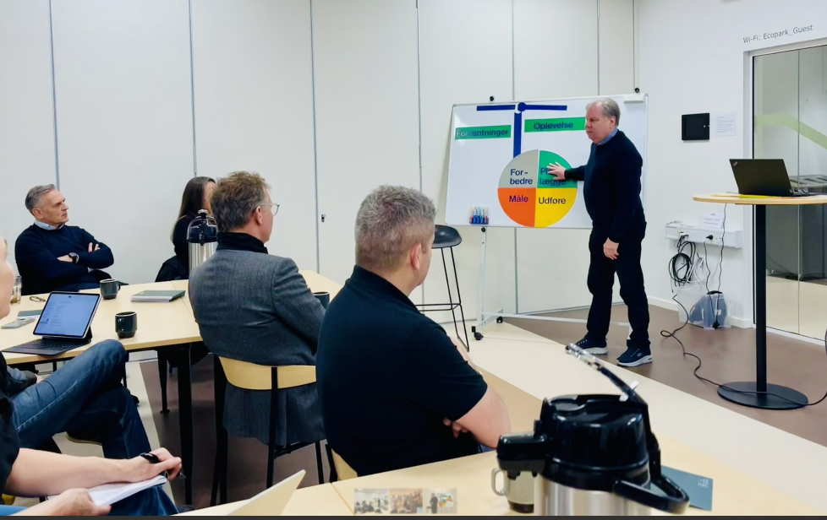
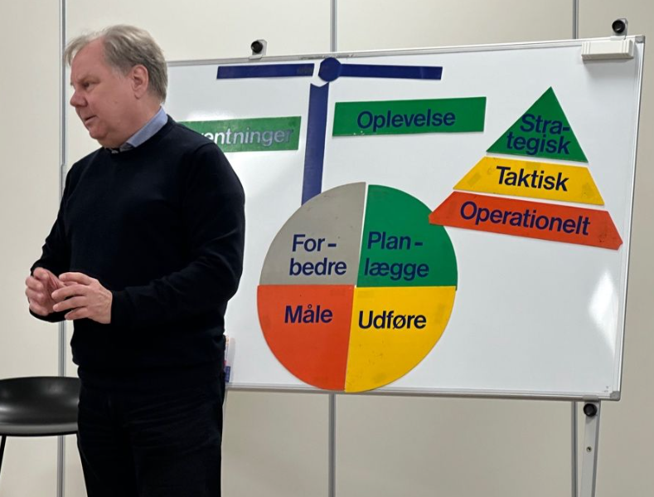

Slide 4
Referencer
Volvo Data
Danske Bank
TDC
Rigshospitalet
Danmarks Forvaltningshøjskole
Danske Spil
Nordea
Kamstrup
Skatteforvaltningen
Kennedy Instituttet
Teamco Norge
Guide Nordic
HP
Lego
Københavns Brandvæsen
Falck
Logimatic
Abena
Tønder kommune
Søfartsstyrelsen
Nykredit
Århus Købmandsskole
Rigspolitiet
Ericson
Århus Kommunes Børnetandpleje
Bladkompagniet
BP Gas
CCI Europe
Stibo Systems
Landbrugs- og fiskeristyrelsen
Islandske Spil
DHL
MedCom
Konferencer:
Synergi (USA)
IBM Las Vegas (USA)
Westergaard-Metier
ITIL (DK og norden)
DFK (kvalitet)

Slide 5

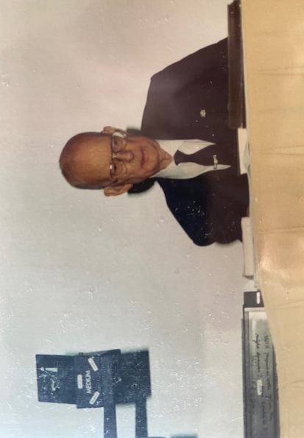

Slide 6
Firma | Standard | År
LEC | ISO 9001 | 1991
KDdata | ISO 9001 | 1993
BP Gas | ISO 9001 | 1993
DMdata | ISO 9001 | 1999
IBM Danmark | ISO 9001 | 2004
Itadel | ISO 27001 | 2018
IT Relation | ISO 27001 | 2022
Itm8 | ISO 27001 | 2024

Slide 7


Slide 8
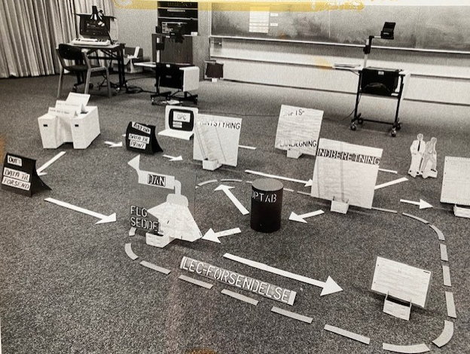

Slide 9
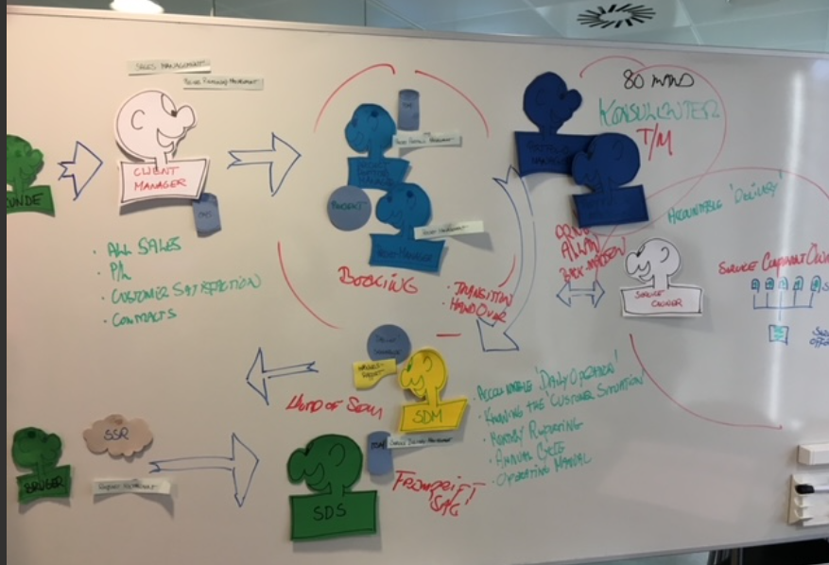

Slide 10
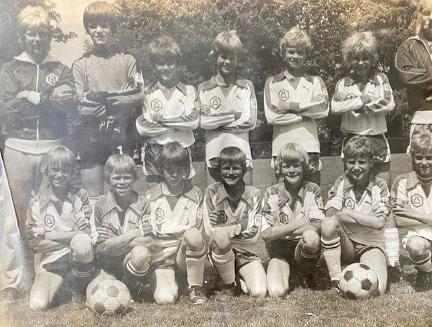
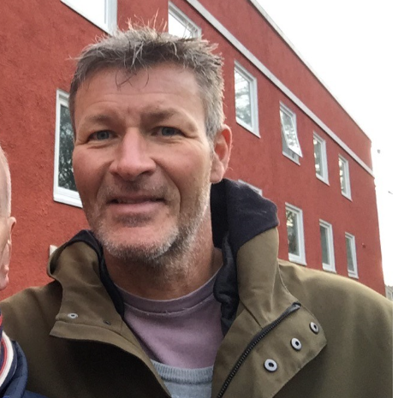

Slide 11
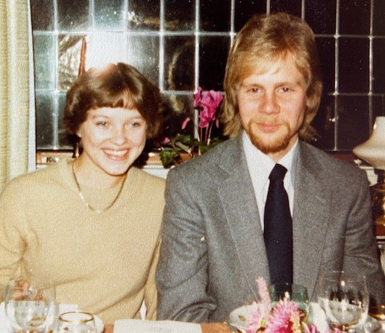
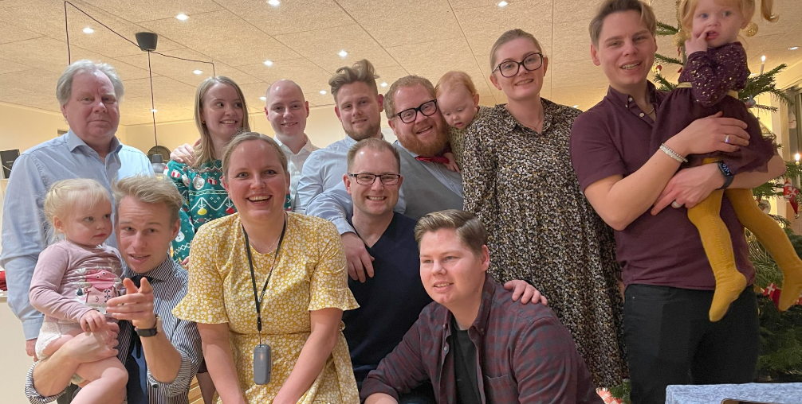

Slide 12
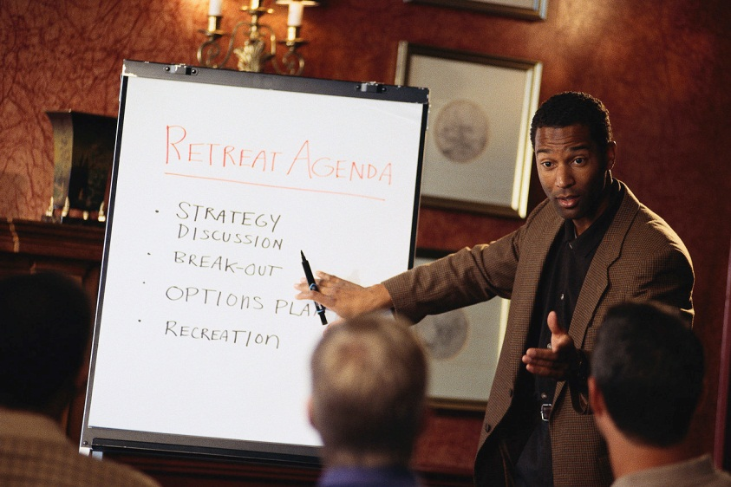

Agenda
Forudsætninger
Begreber
Services
Processer
Systemer
Roller
Intern audit
Next step
Eventuelt

Slide 13
ITR Begrebsapparat
IT Relation

Slide 14
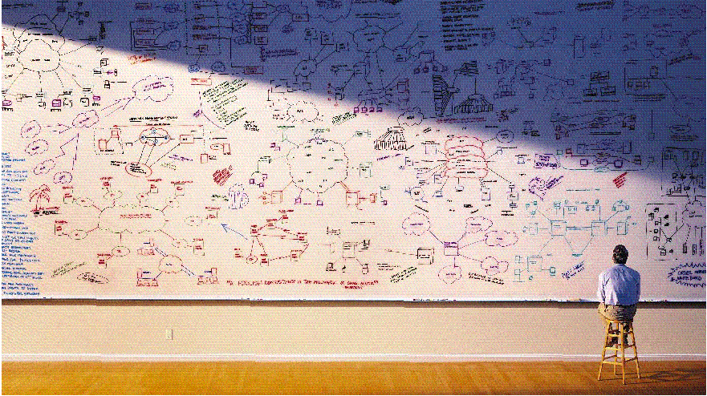
Hvordan ser verden egentlig ud ……

Slide 15
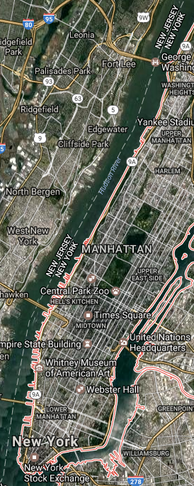
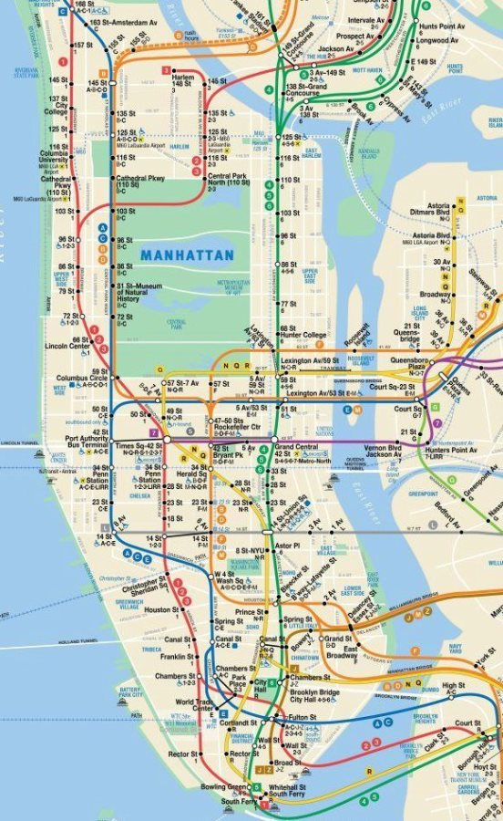
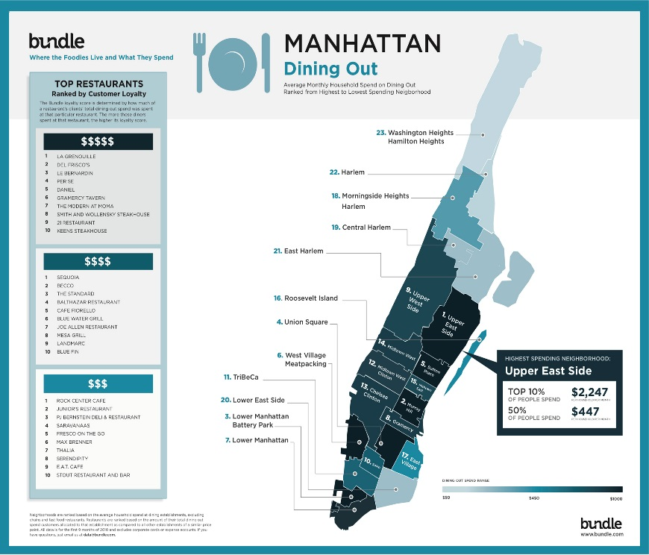
Forskellige arkitektur views til forskellige anvendelsesområder De er alle 100% korrekte men tjener forskellige formål

Slide 16
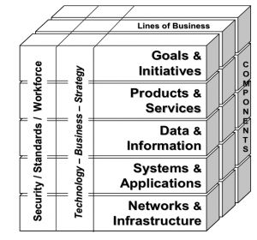
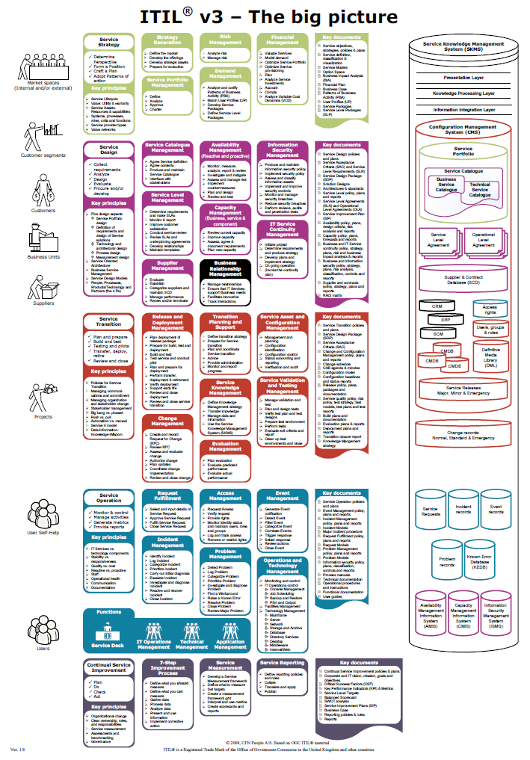
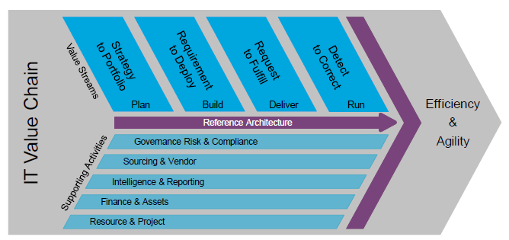

Slide 17
Kvalitet
Forventning
Oplevelse

Slide 18
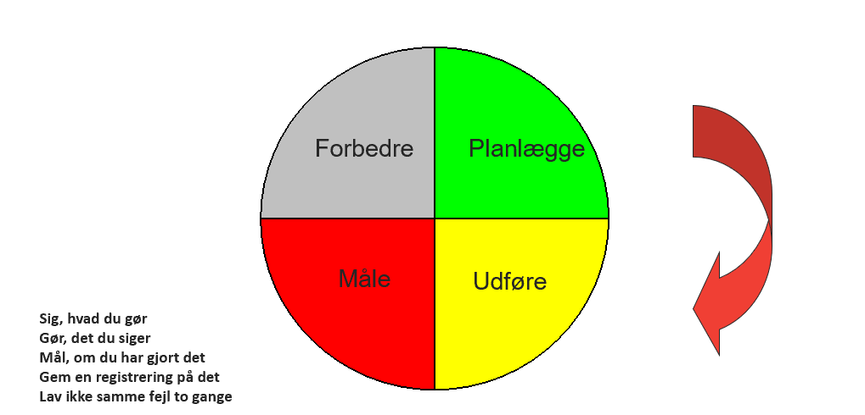
Demings cirkel….

Slide 19

Ledelsessystem (Kvalitet/Informationssikkerhed)

Slide 20
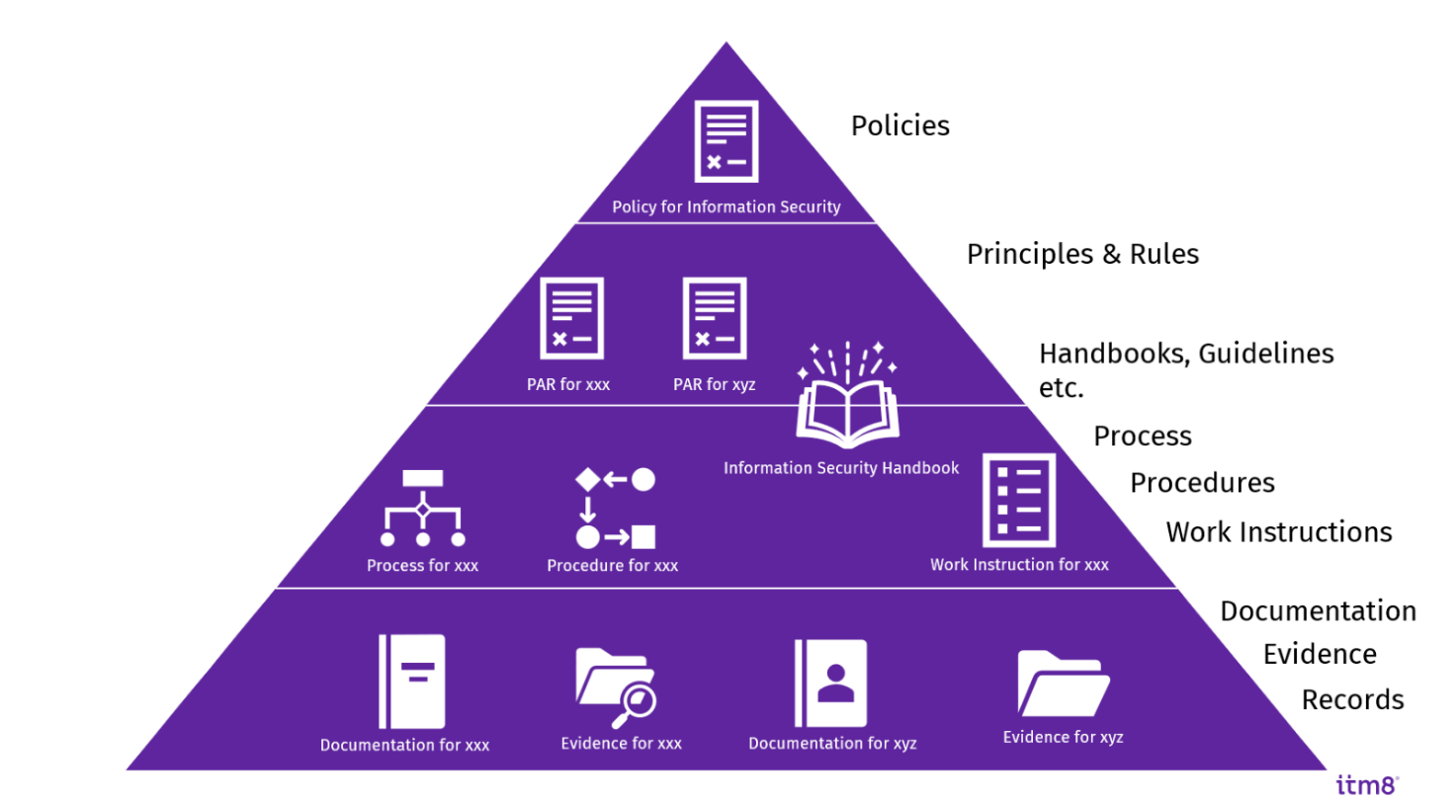

Slide 21






Datamodel
Besty
relse
Service ejer
Kundeansvarlig
Organisation
Service
Kunde System
Kunde
Medarbejder
Rolle
Proces
Proces ejer
Risici
Leverandør
System
Data
Risiko ejer
Leverandør ansvarlig
System ansvarlig
Data ansvarlig

Slide 22
Datamodel
Besty
relse
Service ejer
Kundeansvarlig
Organisation
Service
Kunde
Medarbejder
Proces
Proces ejer
Risici
System
Risiko ejer
Leverandør ansvarlig
System ansvarlig
Data ansvarlig

Slide 23

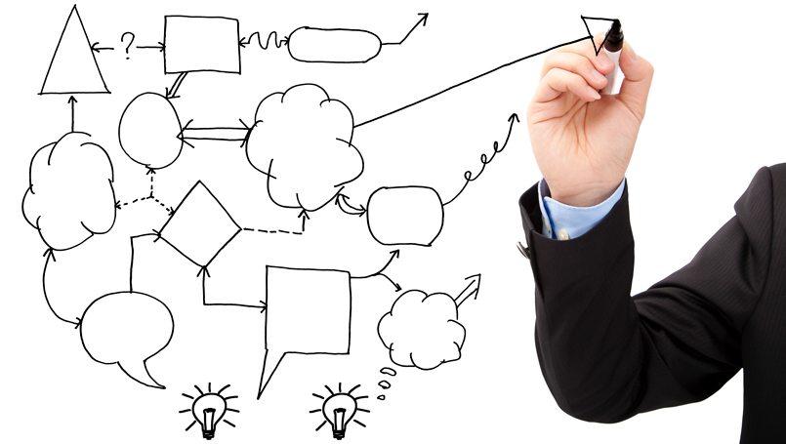

Processes
Systemer

Slide 24
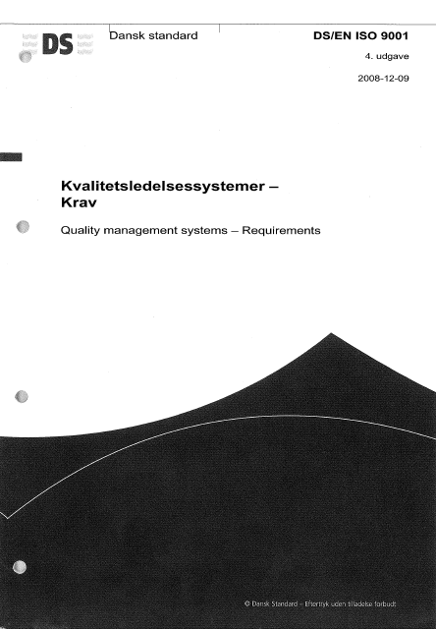



Slide 25
Standards
ISO 27001:2022
GDPR
NIS2
CIS18
Men også
ISO 9001
ISO 22301
ISO 27701
ISO 27005
ISO 19011

Slide 26


Why
Satisfied customer
Effective and efficient employees

Slide 27
ITR Services
IT Relation

Slide 28
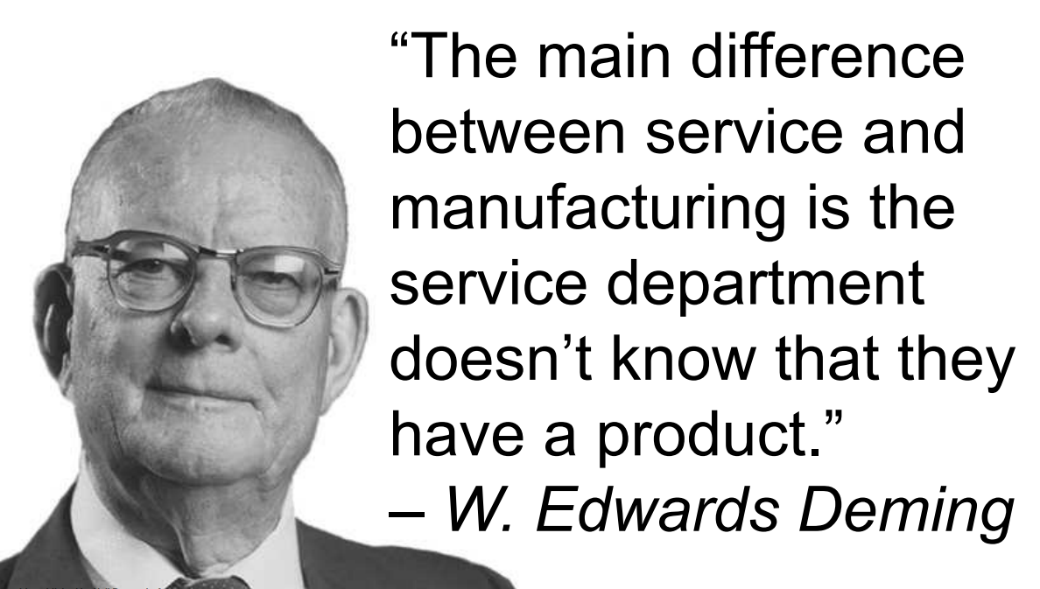

Slide 29
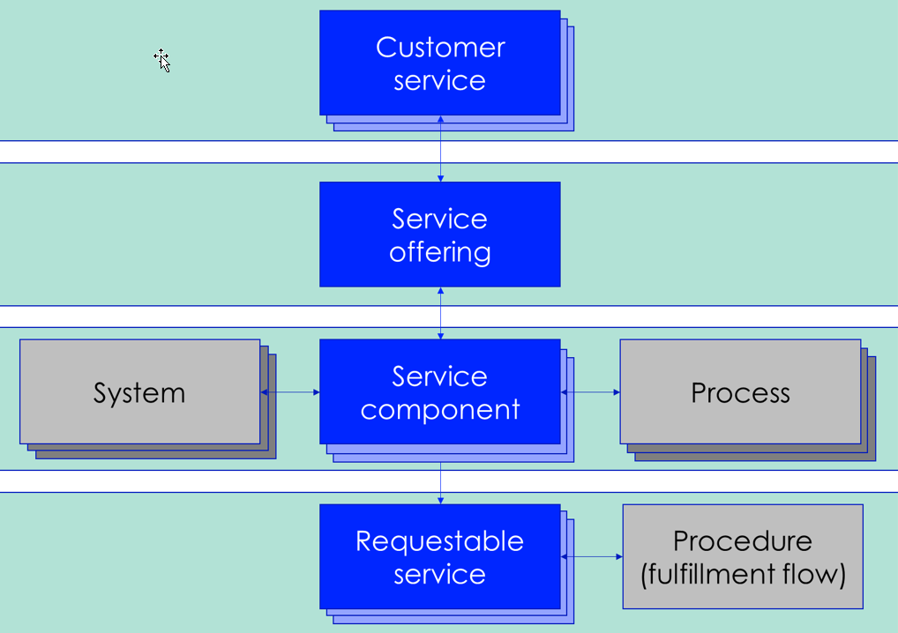
Service model

Slide 30
Service model
30
A Service Offering is what we offer to customers, and it is based on one or more Service Components, one or more systems, and one or more processes. This also emphasizes the need for dialogue between service, system and process owners.
The Service Offering is as an abstract service that will be instantiated in a customer specific configuration every time the Service Offering is sold. A Service Description is describing the Service Component.
The Service Component is offering Goods, Access to resources, and Activities (procedures).
When a service offering is sold to a customer, it becomes a unique instance of the Service Offering – it is now a Customer Service and the documentation includes customer specific agreements. The Customer Service is documented under the customer documentation.
A collection of Itadel Service Components specified in a Contract
A Customer Service is specifically agreed with an SLA with the customer
A customer service is a sold service offering, which is uniquely identifiable and associatedd to a specific customer.
Customer
service
Customer
service
Customer
service
A collection of Itadel Service Components needed to support a Customer Service
A Service Offering can offer options with associated Service Levels
Service offerings can be found in the Itadel Service Catalog
Customer may purchase one or more service offerings.
Service
offering
Service Component are our building blocks - used to form a Service offering.
An Itadel Service Component is the combination of Itadel systems, processes, competencies and agreements (OLA)
Customers cannot purchase service components.
System
Service
component
Process
Customer
service
Customer
service
Customer
service
Customer
service
Customer
service
Customer
service
A request from a user for support or ordering a Requestable Service. For example, to 'reset' a password, or order access through a firewall.
A requestable Service always belongs to a Service Component, but will be requested through a Service Packages – a Customer Service
Requestable service
Procedure (fullfilment flow)
Customer
service
Customer
service

Slide 31
Service component owner
Consult Service Portfolio Manager, Finance and Service Component Owner before changes - in some cases, consulting other stakeholders may be relevant
Informing service catalogue owner upon changes
Include business continuity planning in new or changed services
Ensure compliance with requirements (customer requirements, legislation, internal)
Ensuring SC monitoring on service performance
Defining monitoring metrics
Evaluating based on customer satisfaction surveys and other monitoring
Periodical risk evaluation
Follow up on internal audit findings
Cost responsible
Service owner is appointed in the service planning phase.
The service owner owns a service component and must be qualified to accommodate business requirements as well as technical requirements when defining or maintaining the service.

Slide 32
Process udviklings metode
Servicepakken
Service / Ydelse
Sekundær services
Film
Mini bar
Primær service
Hotel
overnatning
Hurtig checkout
Hygiejne
Svimming Pool
Notes:
DK: ”Service Pakker” - > US ?

Slide 33
Kundens fordele
Fakta om service
Forudsætninger/forbehold
Sådan leveres service

Slide 34
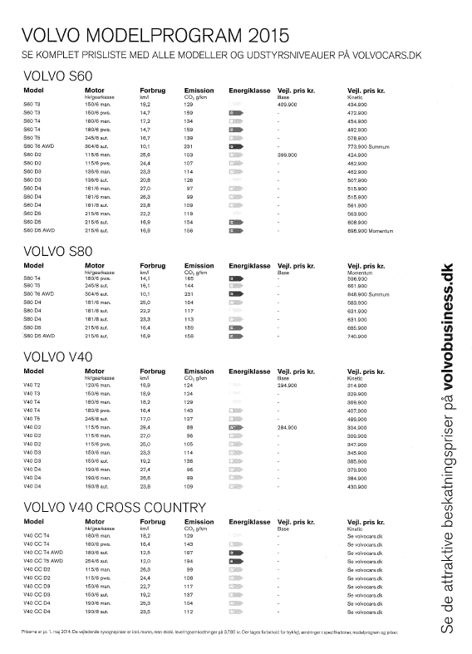



Slide 35

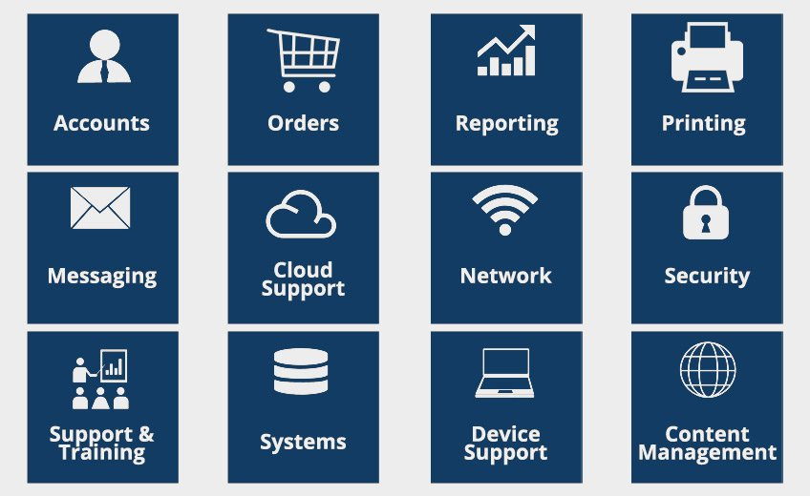
Service Catalogue

Slide 36


Slide 37
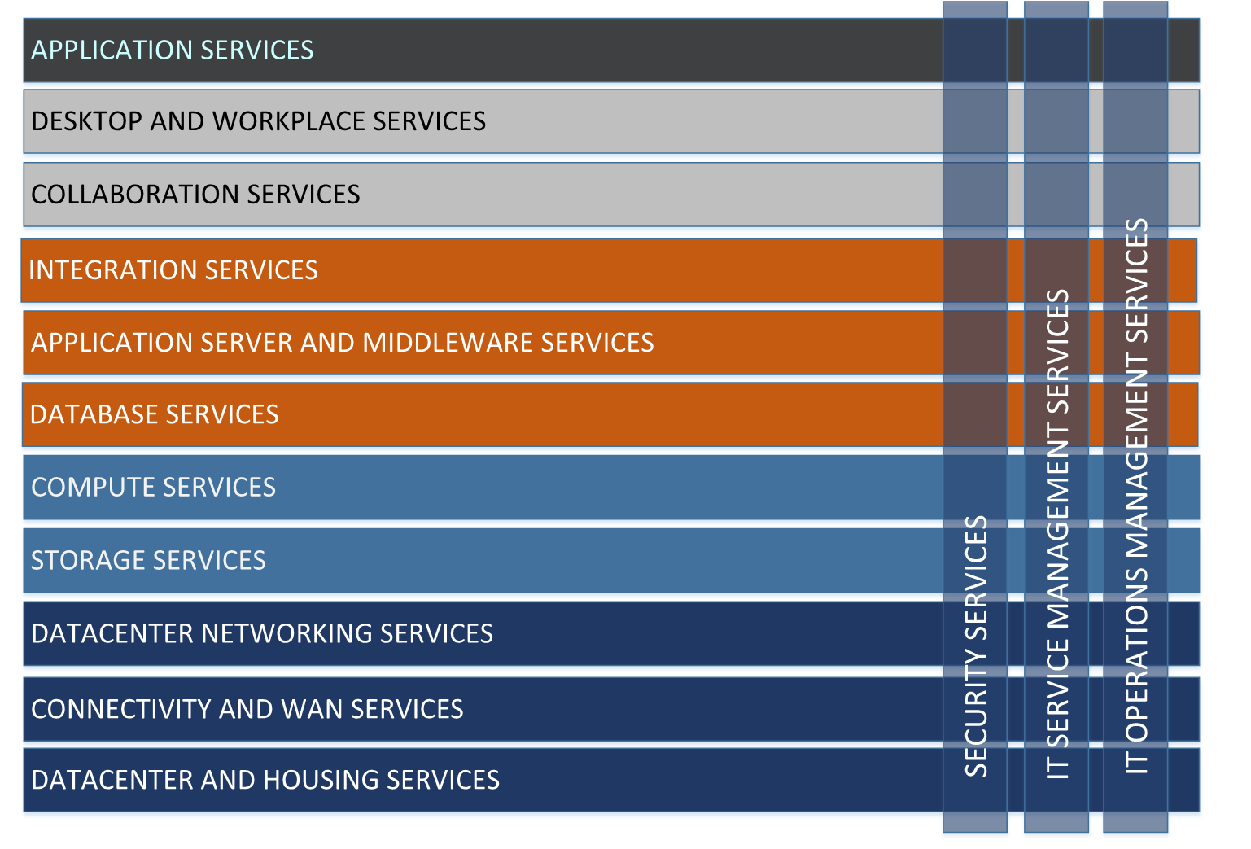

Slide 38

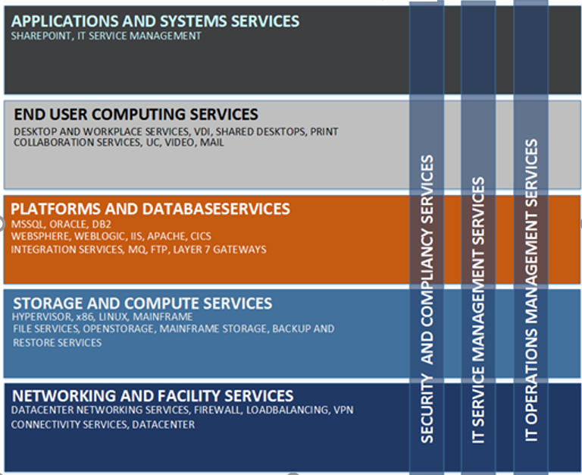
Hvad sælger vi?
Software as a Service
Desktop as a Service
Platform as a Service
Infrastructure as a Service
Housing
as a Service

Slide 39
Data model
Agreements
Service offering
Customer contract
Basis level
(it all starts here)
System
Service (component)
Process
Ad on services
Requestable service
Procedure
level
Documentation
Fulfillment flow
Procedure
Contract addendum
Instruction
level
SOP
Work instruction
Customer instructions

Slide 40
ITR Processes
IT Relation

Slide 41
Process model
41
SALES & MARKETING
RUN
Detect to correct
BUILD
Requirement to Deploy
DELIVER
Request to fulfill
PLAN
Strategy to Portfolio
S1 Marketing
S2 Sales Management
P1 Business Relationship Management
P2 Demand Management
P3 Project Portfolio Management
P4 Service Portfolio Management
P5 Strategy Management
P6 Manage Innovation
P7 Manage Enterprise Architecture
B1 Service Design & Build
B2 Availability Management
B3 Capacity Management
B4 Project Management
B5 Service Validation & Testing
B6 IT Service Continuity Management
D1 Change Management
D2 Asset & Configuration Management
D3 Release & Deployment Management
D4 Lifecycle Management
D5 Service Catalogue Management
D6 Request Fulfillment
D7 Service Delivery Management
R1 Identity & Access Management
R2 Manage Operational Security
R3 Event Management
R4 Incident Management
R5 Problem Management
R6 Manage Operation
R7 Consulting Services
R8 Resource Management
Finance
Human Ressource
Quality
Security, Risk and Compliance
F1 Account payable
F2 Account receivable
F3 General ledger
F4 Bank
F5 Budget
F6 Fixed assets
F7 Reports & KPI
F8 Procurement & Vendor Management
F9 License Management
F10 Business Intelligence
F11 Payroll Management
H1 Organization hieracy and policies
H2 Recruitment Management
H3 Employee Onboarding and Development
H4 Employee change & Exit management
H5 Compensation and benefits
H6 Manage leave and absence
Q1 Document Management
Q2 Quality Management
C1 Internal Audit
C2 Management Review
C3 Information Security Management
C4 Enterprise Risk Management

Slide 42
Operational Processes
Support Processes
Process Framework
SALES & MARKETING
Go to market
RUN
Detect to correct
BUILD
Requirement to Deploy
DELIVER
Request to fulfill
PLAN
Strategy to Portfolio
S1 Marketing
S2 Sales Management
P1 Business Relationship Management
P2 Demand Management
P3 Project Portfolio Management
P4 Service Portfolio Management
P5 Strategy Management
P6 Manage Innovation
P7 Manage Enterprise Architecture
B1 Service Design & Build
B2 Availability Management
B3 Capacity Management
B4 Project Management
B5 Service Validation & Testing
B6 IT Service Continuity Management
D1 Change Management
D2 Asset & Configuration Management
D3 Release & Deployment Management
D4 Lifecycle Management
D5 Service Catalogue Management
D6 Request Fulfillment
D7 Service Delivery Management
R1 Identity & Access Management
R2 Manage Operational Security
R3 Event Management
R4 Incident Management
R5 Problem Management
R6 Manage Operation
R7 Consulting Services
R8 Resource Management
Finance
Accounting
Finance
Contract and Billing
Human Resource
Quality
Security, Risk and Compliance
F01 Account payable
F02 Account receivable
F03 General ledger
F04 Bank
F05 Budget
F06 Fixed assets
F07 Reports & KPI
F08 Procurement & Vendor Management
F09 Business Intelligence
F10 Payroll Management
G01 License Management
G02 Financial Management
G03 Invoicing
H1 Organization hierarchy and policies
H2 Recruitment Management
H3 Employee Onboarding and Development
H4 Employee change & Exit management
H5 Compensation and benefits
H6 Manage leave and absence
Q1 Document Management
Q2 Quality Management
C1 Internal Audit
C2 Management Review
C3 Information Security Management
C4 Enterprise Risk Management

Slide 43
Process owner
Consult stakeholders (service/system/data/contract owners) before process changes
Ensure training of process users
Ensure compliance with requirements (customer requirements, legislation, internal)
Define monitoring metrics and ensure implementation
Obtain input from other relevant sources (e.g. customer/employee satisfaction surveys)
Annual process evaluation - documented
Based on incidents and risks, evaluate process when necessary
At least annually formal risk evaluation
Follow up on internal audit findings
Process owner must obtain the position of Head of Department or higher.
The process owner may appoint a process manager to carry out day-to-day activities. In which case this must be reflected in process documentation.

Slide 44
Document types
ISO 27001
PAR
for
………..
Policy
for
………..
Work Instruction
Policy
for
………..
Process for
………..
Procedure
Process for
………..
Work Instruction
Procedure
Work Instruction
Evidence
What we are selling
Records
Procedure
Service
Work Instruction
Service

Slide 45
Policy
Collection of principles which are governing Itadel
Approved and owned by an EMT member
Reviewed and monitored by InfoSec
Targeting: Staff and customers
Policies:
Governance framework (new)
Disciplinary action policy (new)
Information security policy
Quality policy (new)
Policy for document management (new)

Slide 46
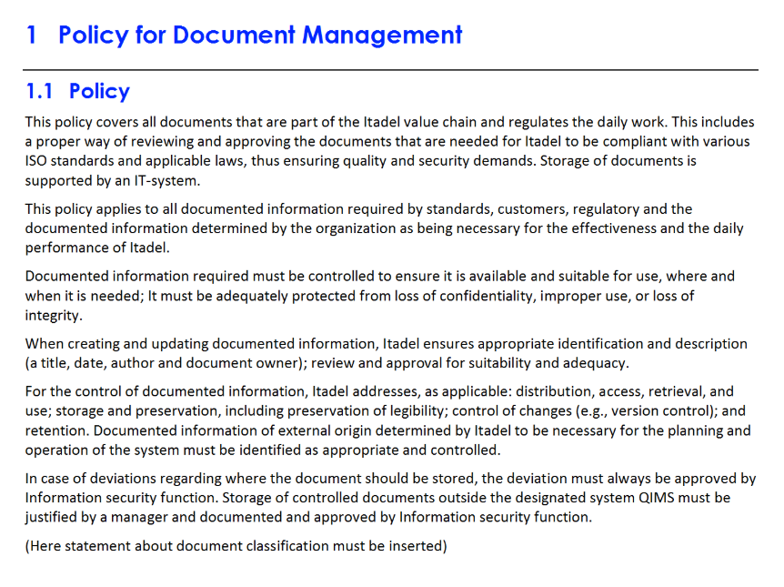
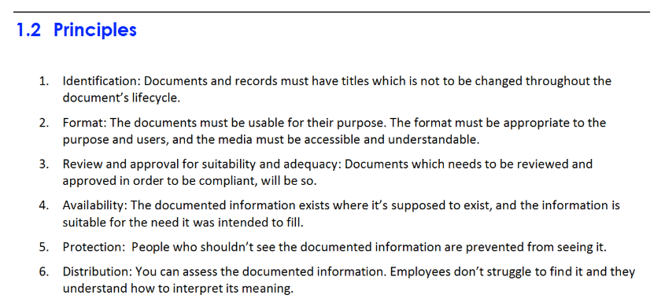
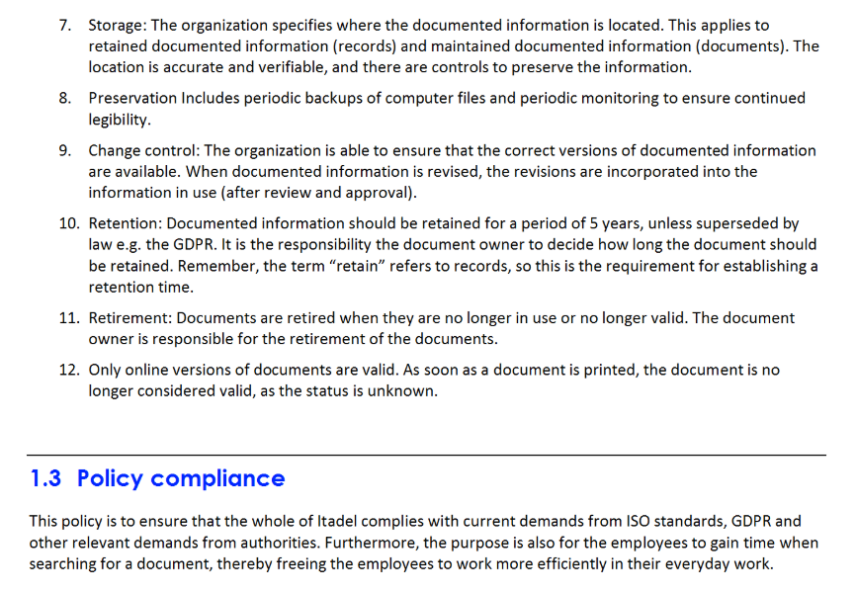
Policy (example)

Slide 47
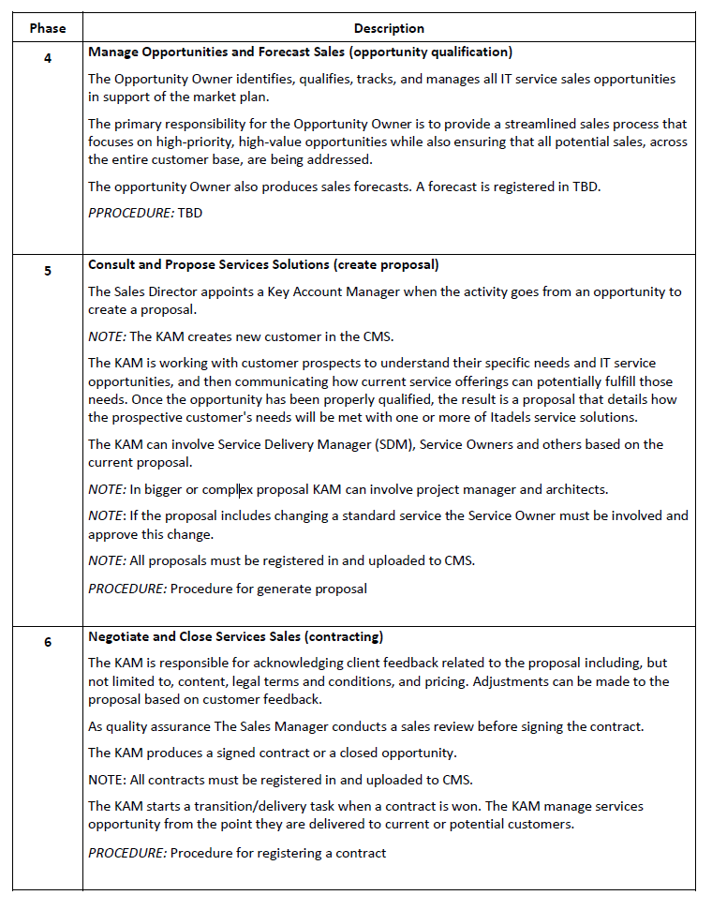
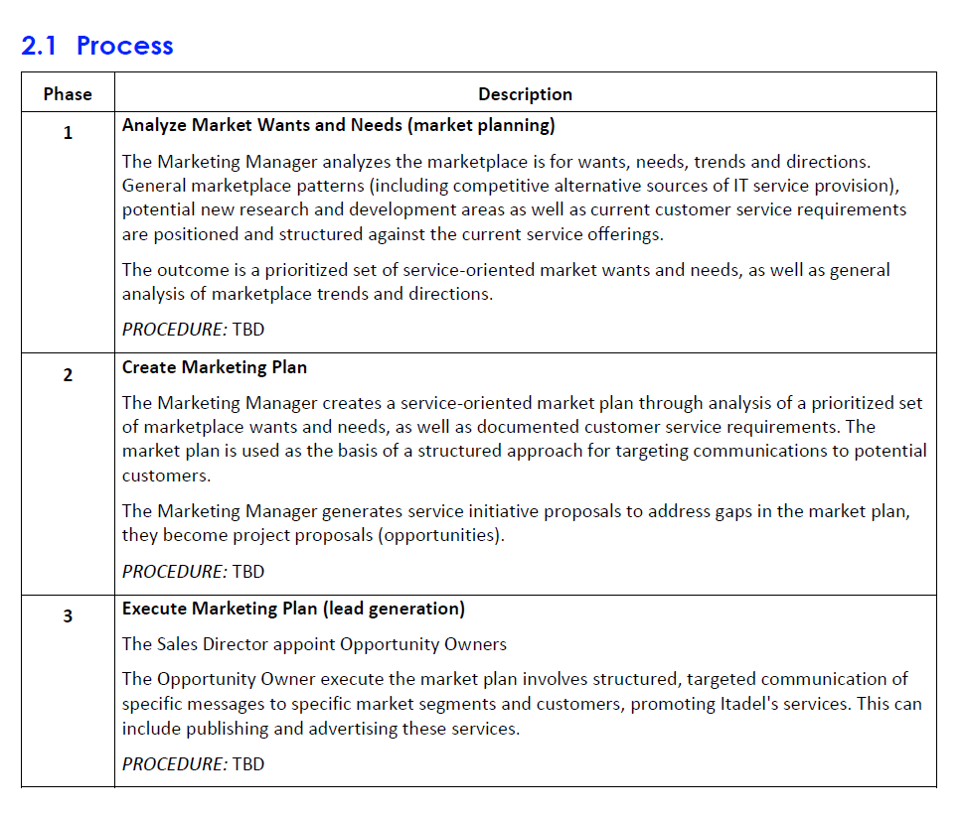
S1 Service Sales & Marketing

Slide 48
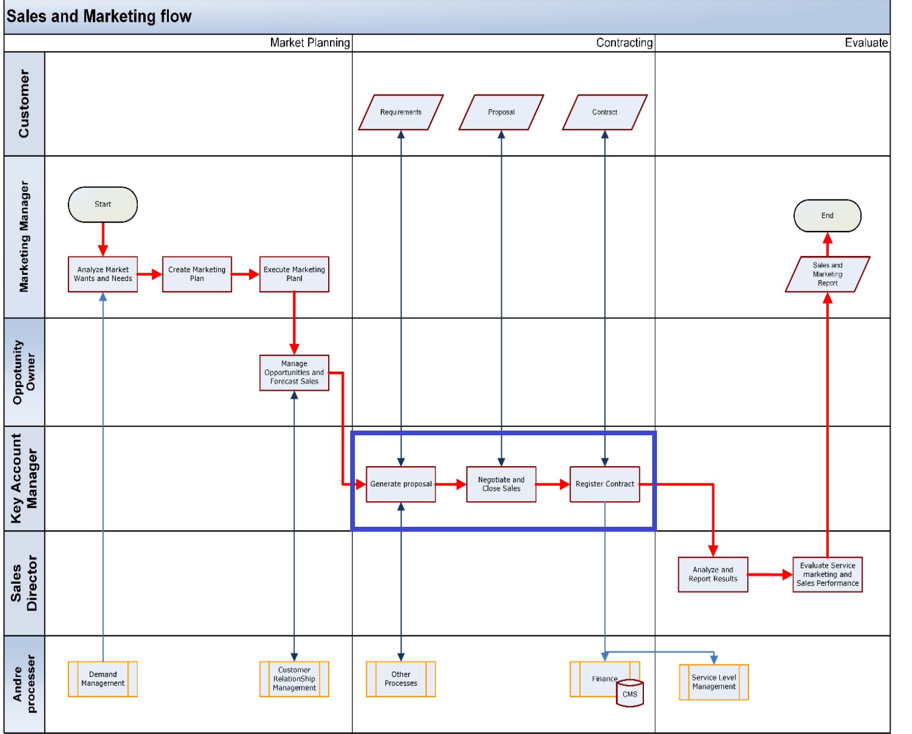

Slide 49
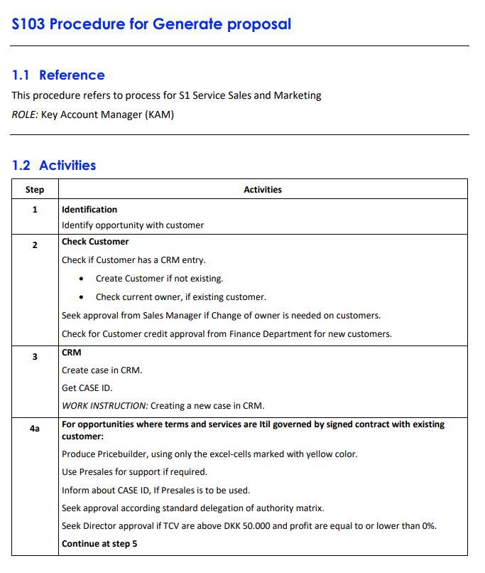
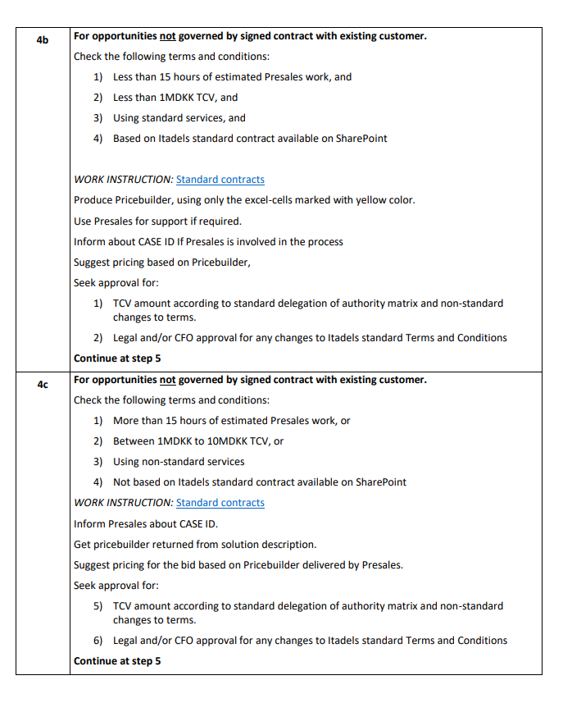

Slide 50
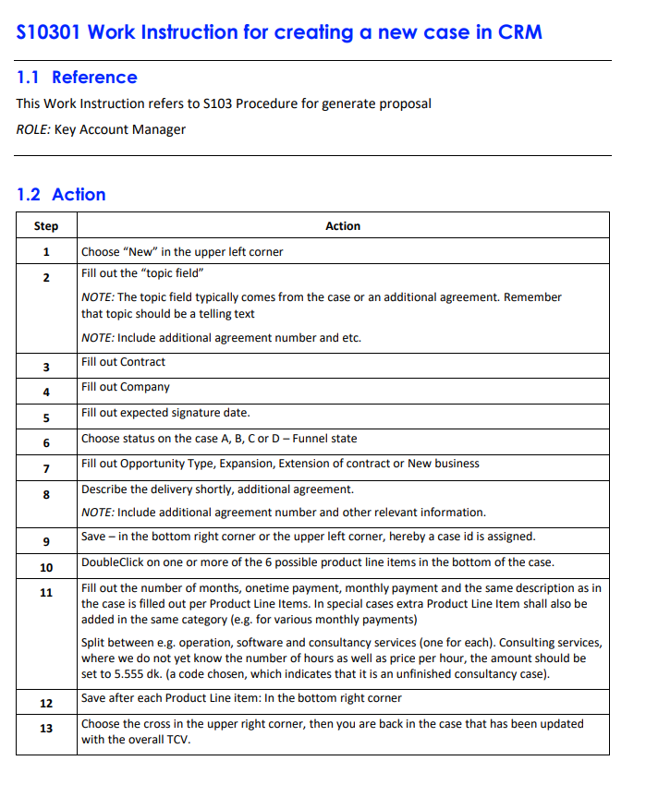

Slide 51
Process model
51
SALES & MARKETING
RUN
Detect to correct
BUILD
Requirement to Deploy
DELIVER
Request to fulfill
PLAN
Strategy to Portfolio
S1 Marketing
S2 Sales Management
P1 Business Relationship Management
P2 Demand Management
P3 Project Portfolio Management
P4 Service Portfolio Management
P5 Strategy Management
P6 Manage Innovation
P7 Manage Enterprise Architecture
B1 Service Design & Build
B2 Availability Management
B3 Capacity Management
B4 Project Management
B5 Service Validation & Testing
B6 IT Service Continuity Management
D1 Change Management
D2 Asset & Configuration Management
D3 Release & Deployment Management
D4 Lifecycle Management
D5 Service Catalogue Management
D6 Request Fulfillment
D7 Service Delivery Management
R1 Identity & Access Management
R2 Manage Operational Security
R3 Event Management
R4 Incident Management
R5 Problem Management
R6 Manage Operation
R7 Consulting Services
R8 Resource Management
Finance
Human Ressource
Quality
Security, Risk and Compliance
F1 Account payable
F2 Account receivable
F3 General ledger
F4 Bank
F5 Budget
F6 Fixed assets
F7 Reports & KPI
F8 Procurement & Vendor Management
F9 License Management
F10 Business Intelligence
F11 Payroll Management
H1 Organization hieracy and policies
H2 Recruitment Management
H3 Employee Onboarding and Development
H4 Employee change & Exit management
H5 Compensation and benefits
H6 Manage leave and absence
Q1 Document Management
Q2 Quality Management
C1 Internal Audit
C2 Management Review
C3 Information Security Management
C4 Enterprise Risk Management

Slide 52
Operational model
52
SALES & MARKETING
RUN
Detect to correct
BUILD
Requirement to Deploy
DELIVER
Request to fulfill
PLAN
Strategy to Portfolio
Value stream A
S1 Sales
S2 Service Level Management
P1 Business Relationship Management
P2 Demand Management
P3 Project Portfolio Management
P4 Service Portfolio Management
P5 Strategy Management
P6 Manage Innovation
P7 Manage Enterprise Architecture
B1 Service Design & Build
B2 Availability Management
B3 Capacity Management
B4 Project Management
B5 Service Validation & Testing
B6 IT Service Continuity Management
D1 Change Management
D2 Configuration Management
D3 Release & Deployment Management
D4 Lifecycle Management
D5 Service Catalogue Management
D6 Request Fulfillment
R1 Identity & Access Management
R2 Manage Operational Security
R3 Event Management
R4 Incident Management
R5 Problem Management
R6 Manage Operation
R7 Consulting Services
Value stream B
Value stream C
Finance
Human Ressource
Quality
Security, Risk and Compliance
F1 Financial Management
F2 Procurement & Vendor Management
F3 Asset & License Management
F4 Business Intelligence
H1 Human Ressource
Q1 Document Management
Q2 Quality Management
Q3 Continual Service Improvement
C1 Internal Audit
C2 Management Review
C3 Information Security Management
C4 Enterprise Risk Management

Slide 53
New service
Get ready to deploye the new Service and to invoice the new service
Prioritize the new Service
Get the new Service into the Service Catalogue
Approve the new Service
Build the new Service
Test the new Service
Service validation and testing
Service Portfolio Management
Service Design and Build
Release & Deployment Management
Manage Enterprise Architecture
Service Catalogue Management

Slide 54
New service for existing customer
Build the solution based on a standard service offering
Get ready to deploye the solution
Prioritize the project
Test the solution
Get Approval for deployment to production environment
Deploye the solution
Control the project from start to finish
Manage the solution
Make an agreement
Sales
Service validation and testing
Project Portfolio Management
Service Design and Build
Release & Deployment Management
Project Management
Manage operation
Change Management
Release and Deployment Management

Slide 55
Execute SSR 103 Reset Password
Control the SSR from start to finish
Reset password in ISIM and send an e-mail to customer
Invoice the customer
Find and request the SSR 103
Service Catalogue
Request Fulfillment
Financial Management
Identity & access Management

Slide 56

Internal Audit

Slide 57
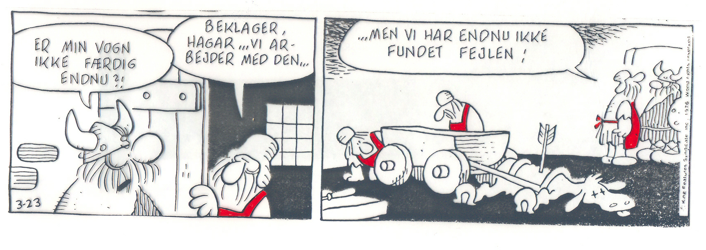
Er tingene som vi tror, de er?

Slide 58
Er tingene som vi tror, de er?

Slide 59
Systemlandskab

Slide 60
Production IT

Slide 61
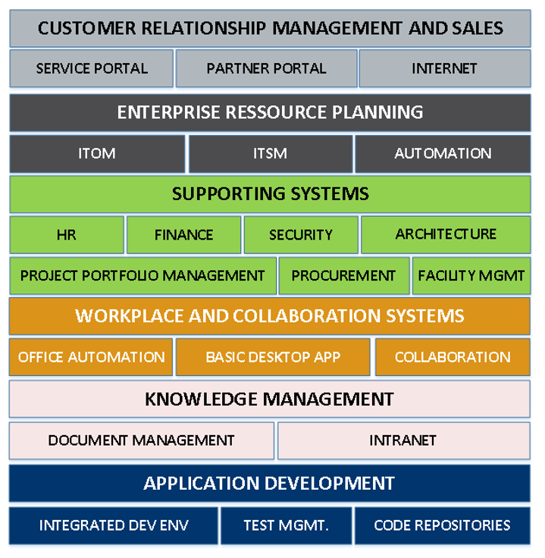
Business IT

Slide 62
System owner
What does this mean for me as…
Approving security requirements during planning
Ensure compliance with requirements (customer requirements, service requirements, legislation, other internal)
Approving changes and preapproved changes (traceable)
Consult stakeholders before changes, when relevant
User information/training when necessary
Performance monitoring planning
Security approval – incl. testing
Ensuring SC monitoring
Evaluate periodically based on monitoring output (e.g. reporting)
Annual risk evaluation (or on major changes)
Follow up on internal audit findings
Ensures valid and correct licensing
For a system, a system owner must be appointed throughout a systems whole life cycle. This means that a system owner must be assigned during the planning phase.
System owners are appointed for Itadel systems only. As Itadel maintains a huge number of systems, a feasible approach could be to appoint owners to vital systems like ServiceNow, CMDB, and generic system types, e.g. Windows OS, Linux OS, MS SQL, Firewall, etc.

Slide 63
Data owner
What does this mean for me as…
Classify data – and enforce
Ensure compliance with requirements (customer requirements, legislation, internal)
Ensure user training where necessary
Define monitoring metrics and method (where necessary)
Monitor for regulative compliance where related to GDPR
Follow up on internal audit findings
Formal risk assessment - annually or on major changes
A data owner owns a clearly defined set of data/information. E.g. Salary information, customer contracts, configuration management information.
Not all data/information has an owner appointed. In such cases it is the responsibility of system owners of data processing systems to ensure sufficient security.

Slide 64
Contract owner
Involving Purchase and License Management in contractual negotiations
Involving Information security for security approval before a vendor is granted access to Itadel system/information
Involving Information Security if a Data Processing Agreement is deemed not necessary or non-standard
Defining and implementing metrics to monitor vendor services
Requesting relevant sources to provide input to vendor evaluation process
Evaluating vendor services and relationship (annually or upon significant incidents)
Formal risk assessment (at least annually or upon significant incidents)
Contract owner is appointed by Head of (purchasing) department before a new vendor agreement is signed.

Slide 65
Datamodel System
Service
Data
Data
Owner
Process
CI
CI Owner
System Owner
System
SW
License
Installation documentation
Operational procedures
D/R Plan
Test documentation
Deployment documentation
(& decommission)
Releaseplan

Slide 66
Service Design and Build documentation
Service
Design Package
Service Component
Service Validation & testing
System
Requestable Service
Requirements
Analyze & Design
Build
Installation documentation
Test documentation
Operational procedures
D/R Plan
Req Flow (SSR)
Releaseplan
Education
Deployment documentation
(& decommission)

Slide 67
Ansvar

Slide 68
Roller og ansvar
Kunde
Key Account Manager
Produktejer
Bruger
Product Manager
Projektleder
Handlingsleder
Leverandør

Slide 69
Roller og ansvar
Kunde
Key Account Manager
Produktejer
Bruger
Product Manager
Projektleder
Handlingsleder
Leverandør

Slide 70
Som medarbejder skal jeg ….

Slide 71
Som medarbejder skal jeg forstå…….
Processer
Services
Systemer

Slide 72
Som medarbejder skal jeg vide…….
Processer
Services
Systemer
Har jeg udført det effektivt og compliant?
Har jeg en tilfreds kunde?

Slide 73
Document Management

Slide 74
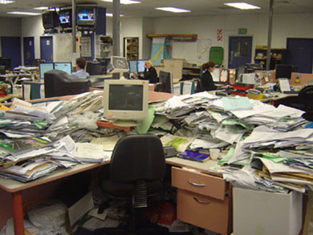
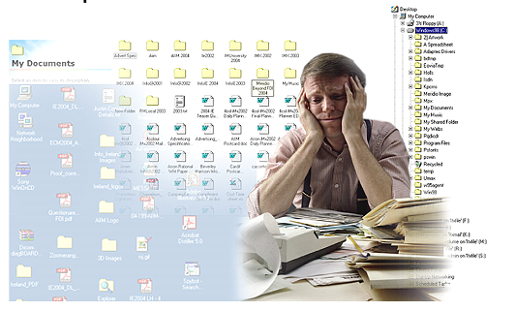
Dokumentstyring (Knowledge Management)

Slide 75
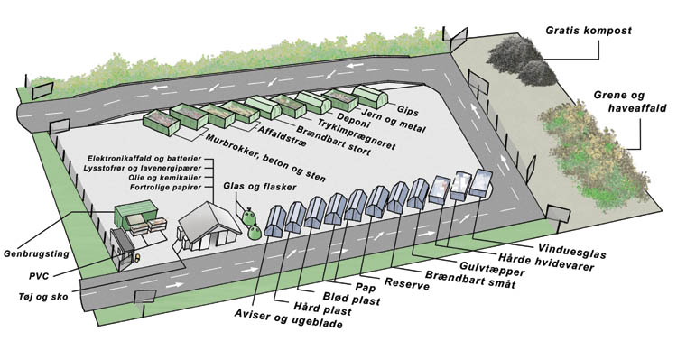
Genanvendelse af informationer
75

Slide 76
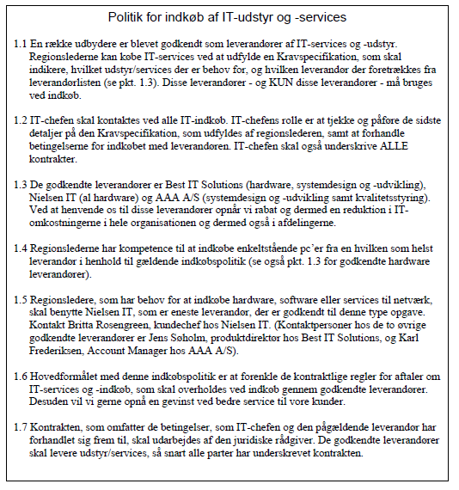

Slide 77
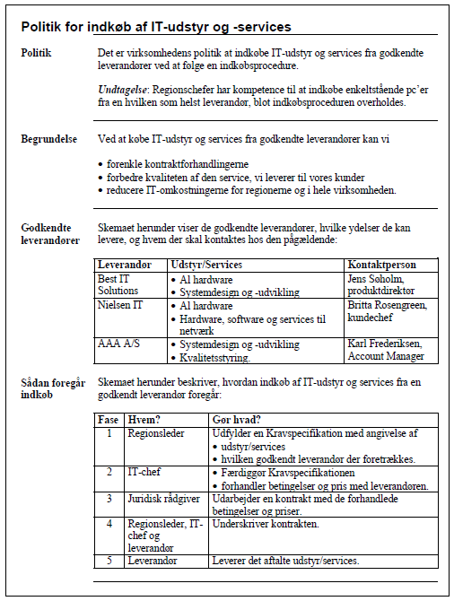

Slide 78
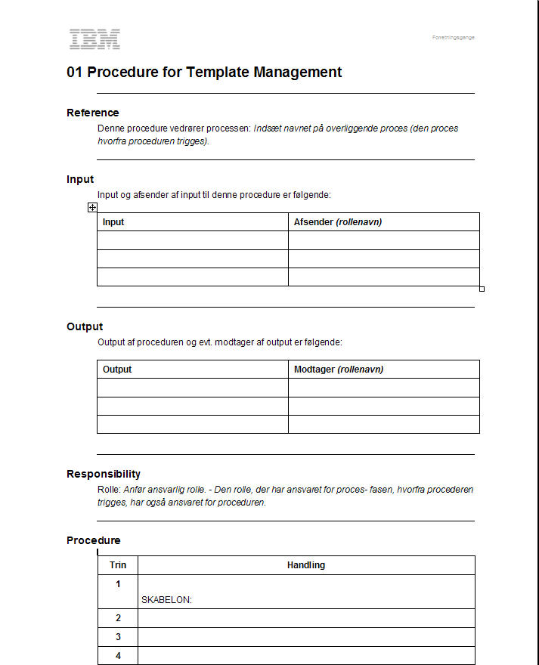
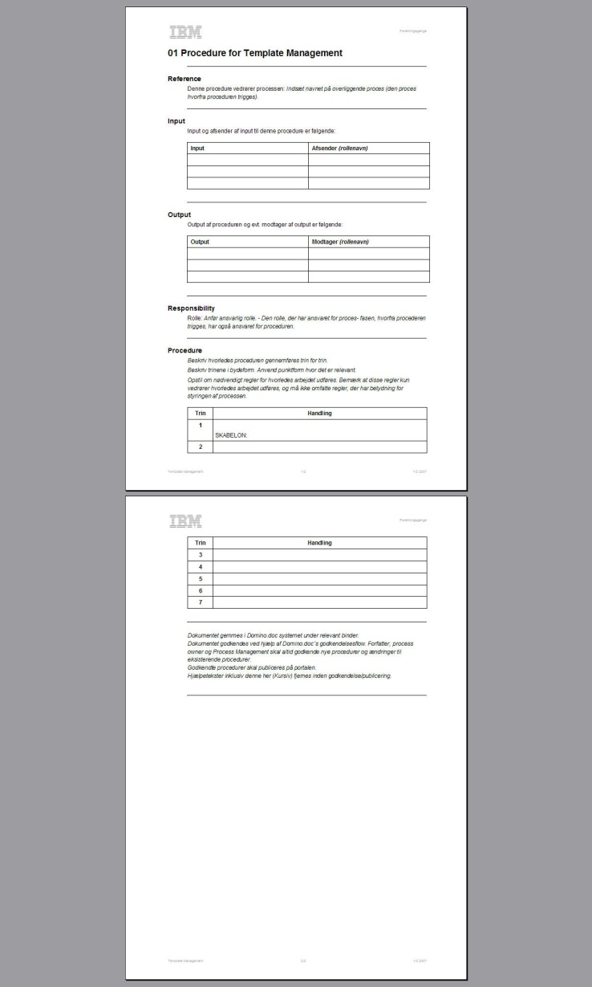

Template Management
Itadel
Itadel

Slide 79
Ekstra

Slide 80
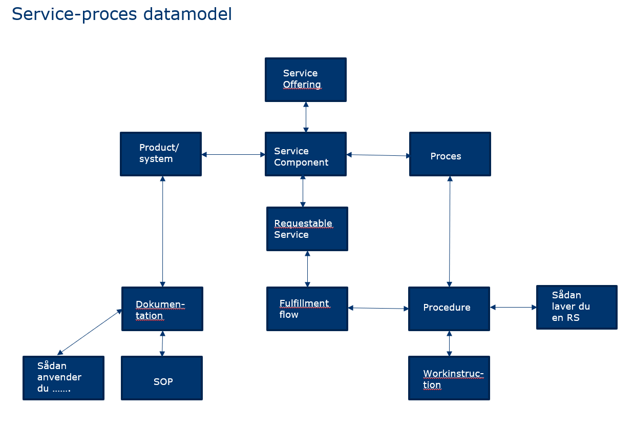

Slide 81

Hvorfor nu alt dette styring …………..
Tilfredse kunder

Slide 82
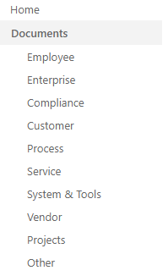

Slide 83
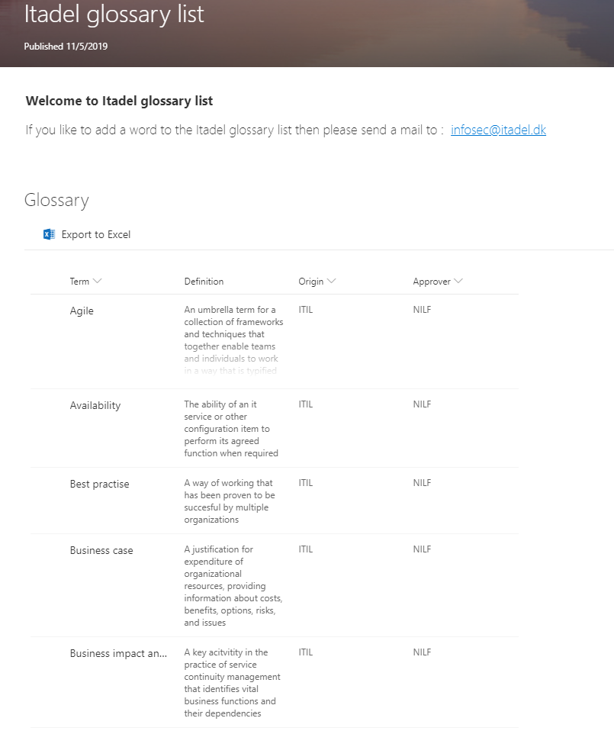
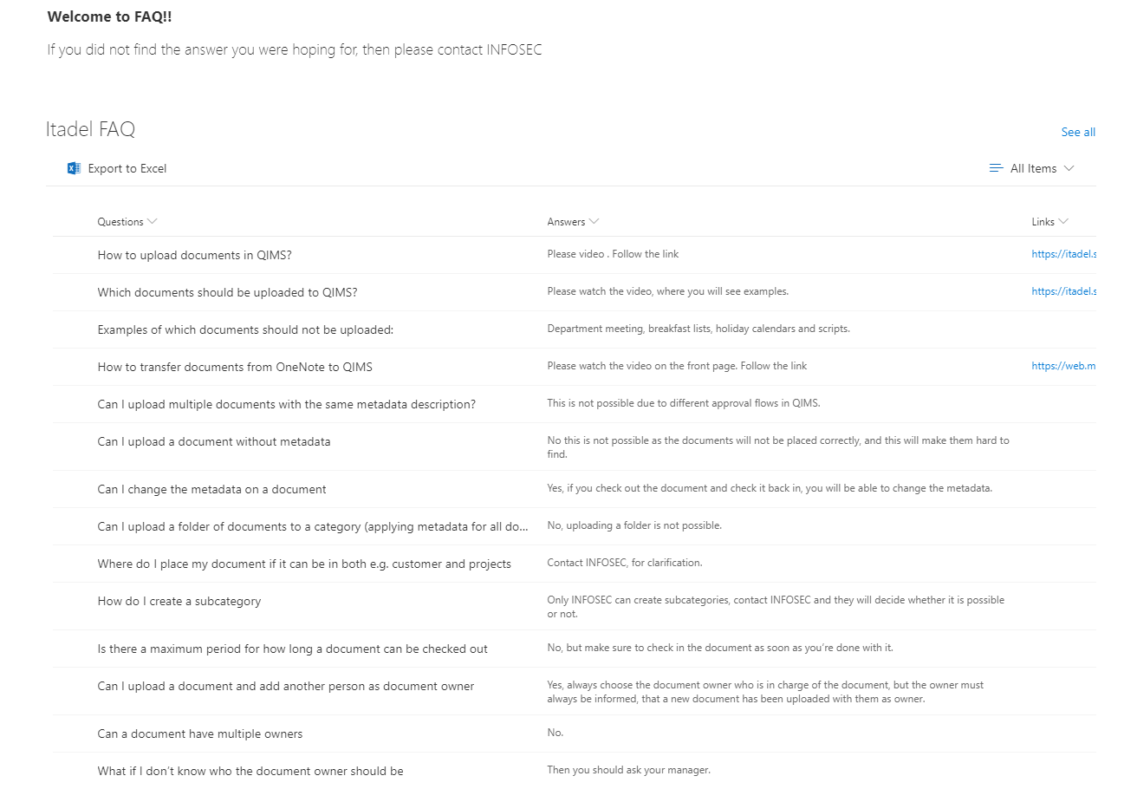

Slide 84
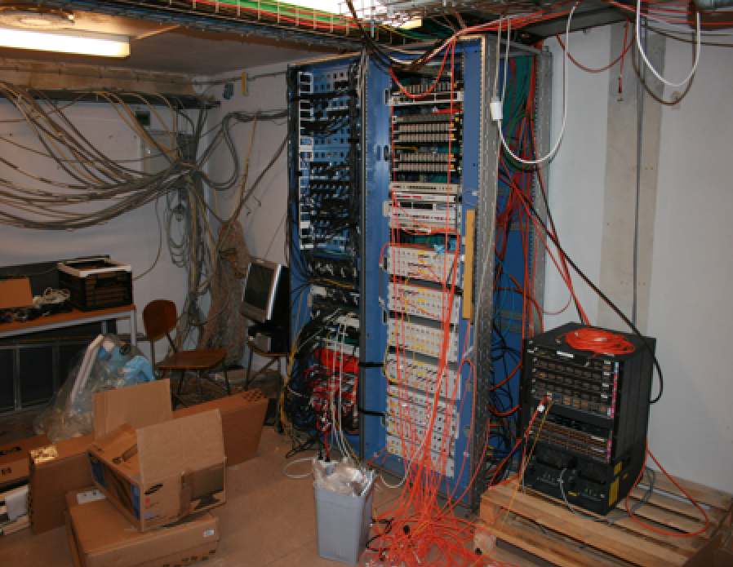
IT drift

